Slide 1
Assistive Technology
EXSM 3929: Module 3

Slide 2
Learning Outcomes
What is the purpose of this module?
List various popular assistive technology types
Practice using a screen reader to navigate the web
Consider the usability of assistive technology
Evaluate and compare to two screen readers

Slide 3
Assignment Prompt
Assignment 1: Screen Reader Assistive Technology Research
Research screen readers
How do you expect to use them?
How would you choose a favourite screen reader?
Assignment is available for download on eClass

Slide 4
Module Resources

Slide 5
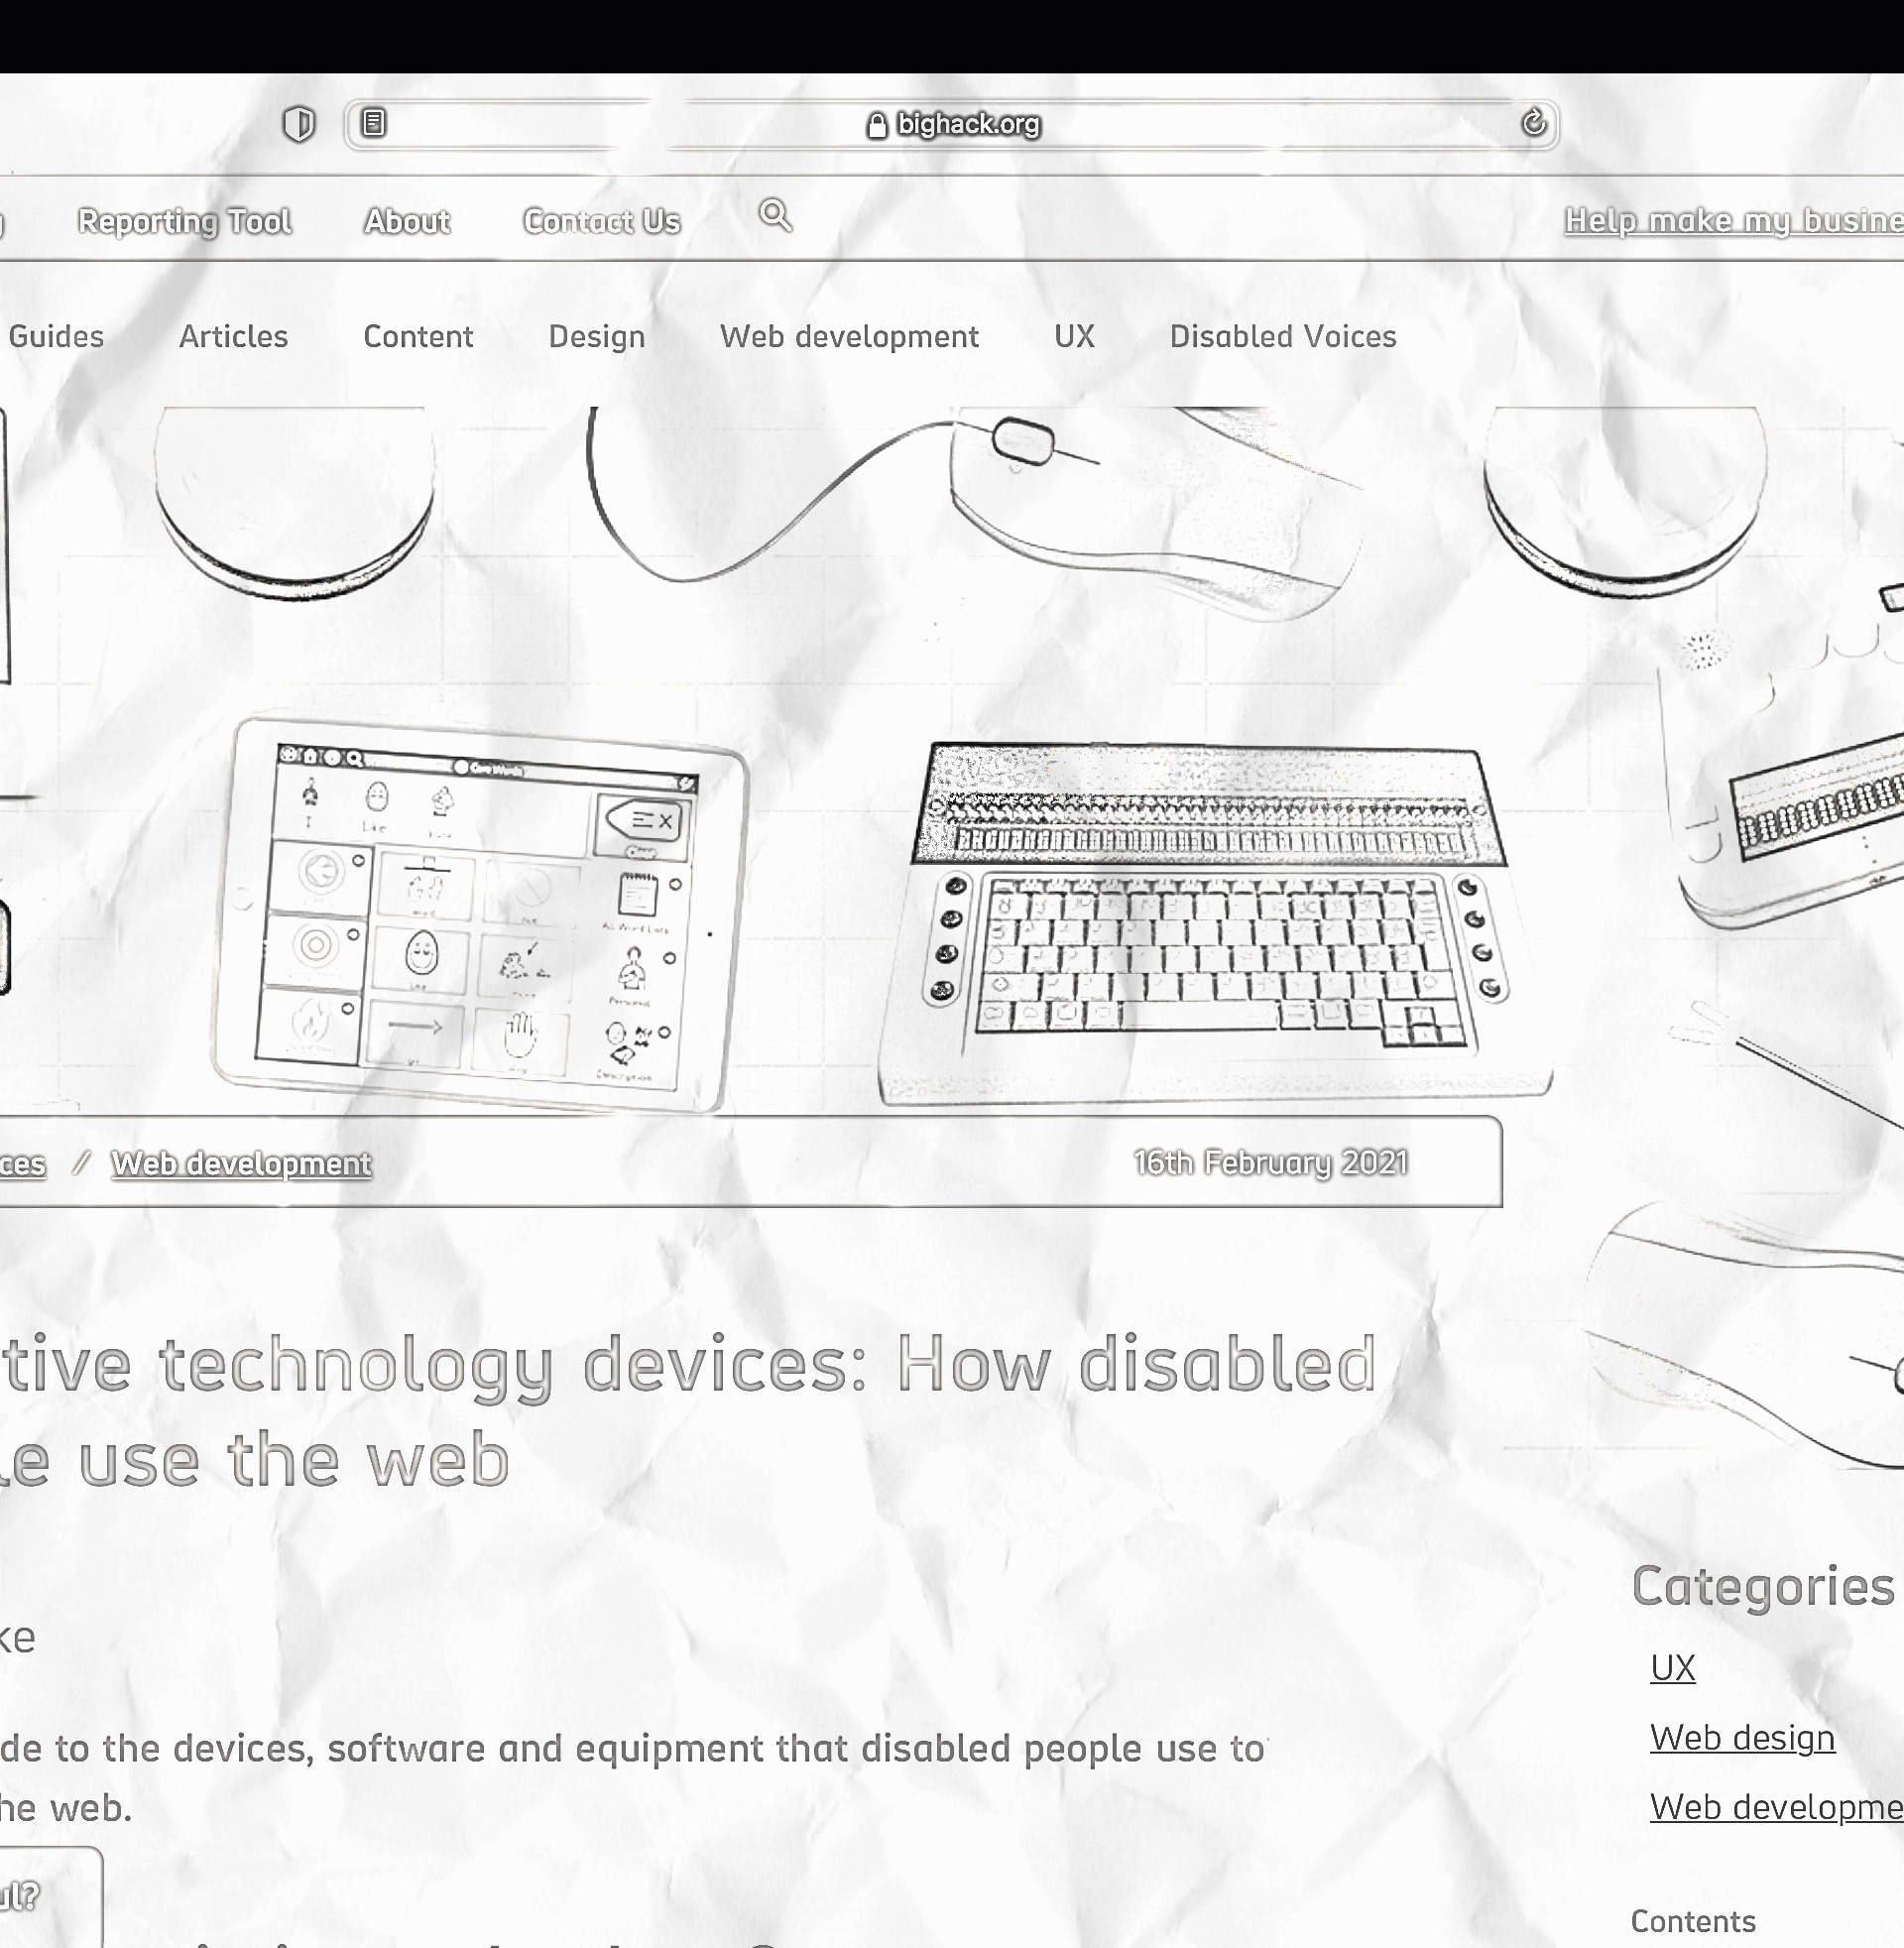
Assistive technology devices: How disabled people use the web
Tuke, H. (2021). bighack.org

Slide 6
“Assistive technology (AT) describes the devices, equipment and software that help disabled people live more independently.”
- Tuke, H., (2021)

Slide 7
Adaptive keyboards
Alternative input devices
Augmentative and Alternative Communication (AAC) tools
Braille display
Braille notetaker
Dictation software
Electronic magnifiers
Optical Character Recognition software (OCR)
Screen magnification software
Screen reader software
Text to Speech Software (TTS)

Slide 8
Your Thoughts
Consider the following questions for our group discussion
Do you have any experience with assistive technologies?
Were you surprised or intrigued by any assistive technology as described?
Do you believe any assistive technologies may be adopted by able bodied individuals?

Slide 9
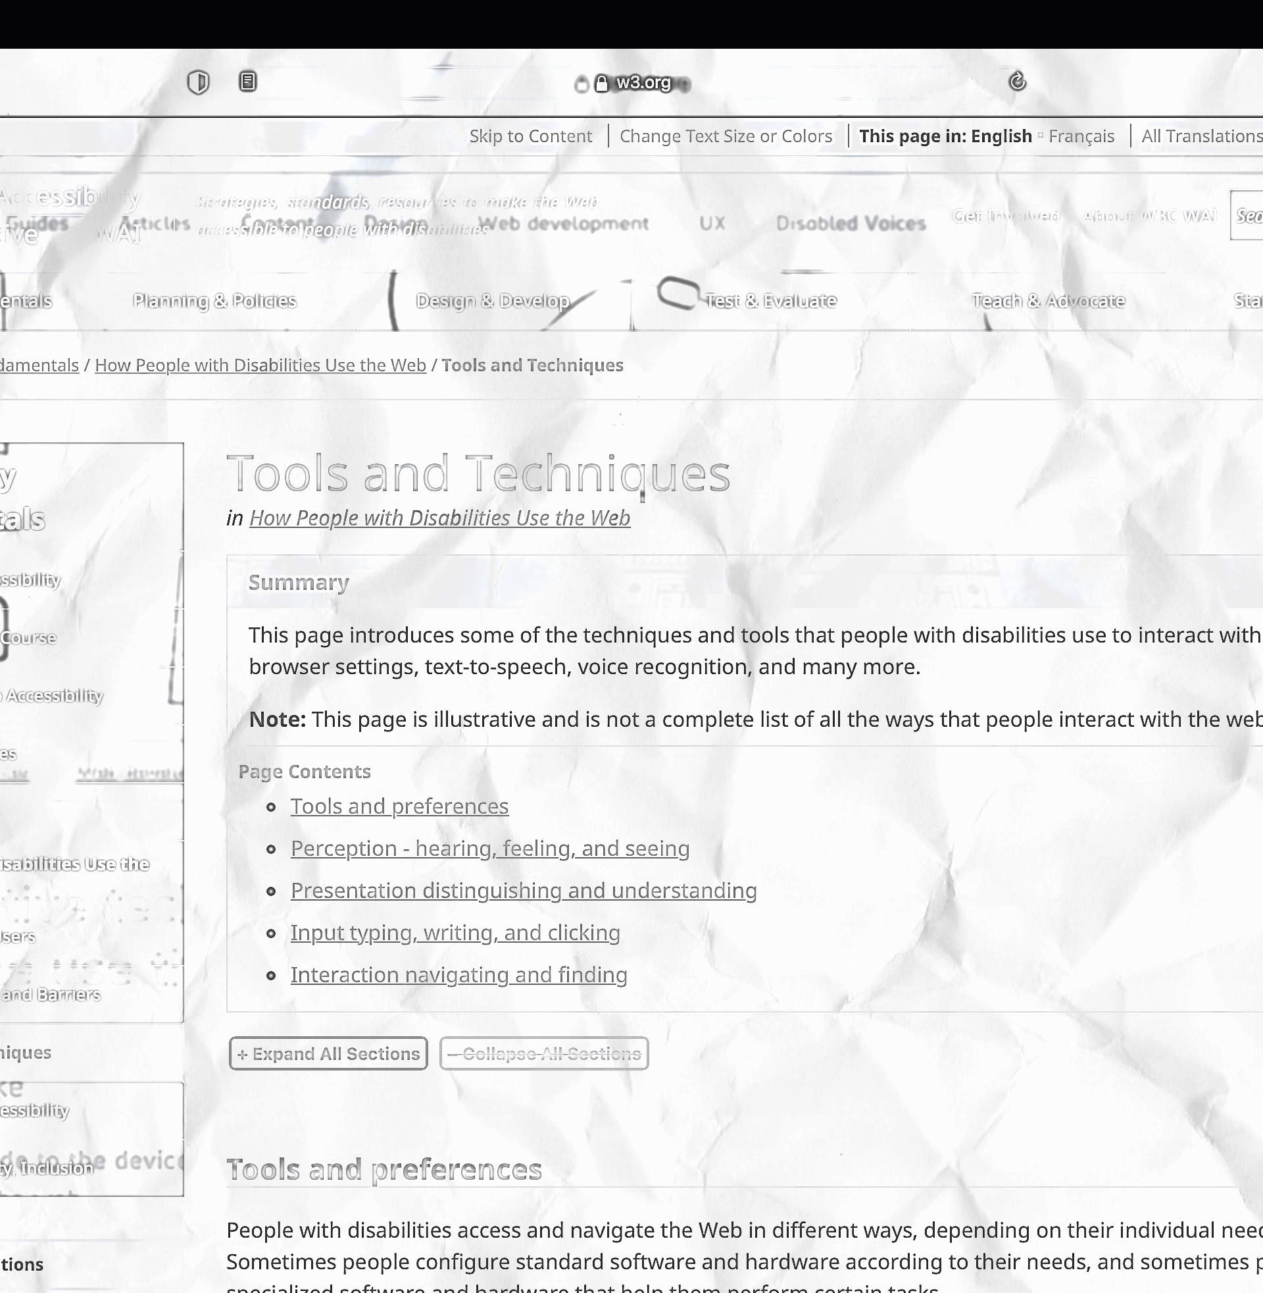
Tools and Techniques
W3. (2017). w3.org

Slide 10
“Sometimes people configure standard software and hardware according to their needs, and sometimes people use specialized software and hardware that help them perform certain tasks.”
- W3, (2017)

Slide 11
Perception (hearing, feeling, visual) - people use different senses
Presentation (distinguishing and understanding) - people want adjust the content
Input (typing, writing, clicking) - people use different approaches
Interaction (navigating and finding) - people use different strategies

Slide 12
Your Thoughts
Consider the following questions for our group discussion
Do you have any adaptive strategies?
Can you describe any favourite digital experiences?
Can you describe any frustrating digital experiences?

Slide 13
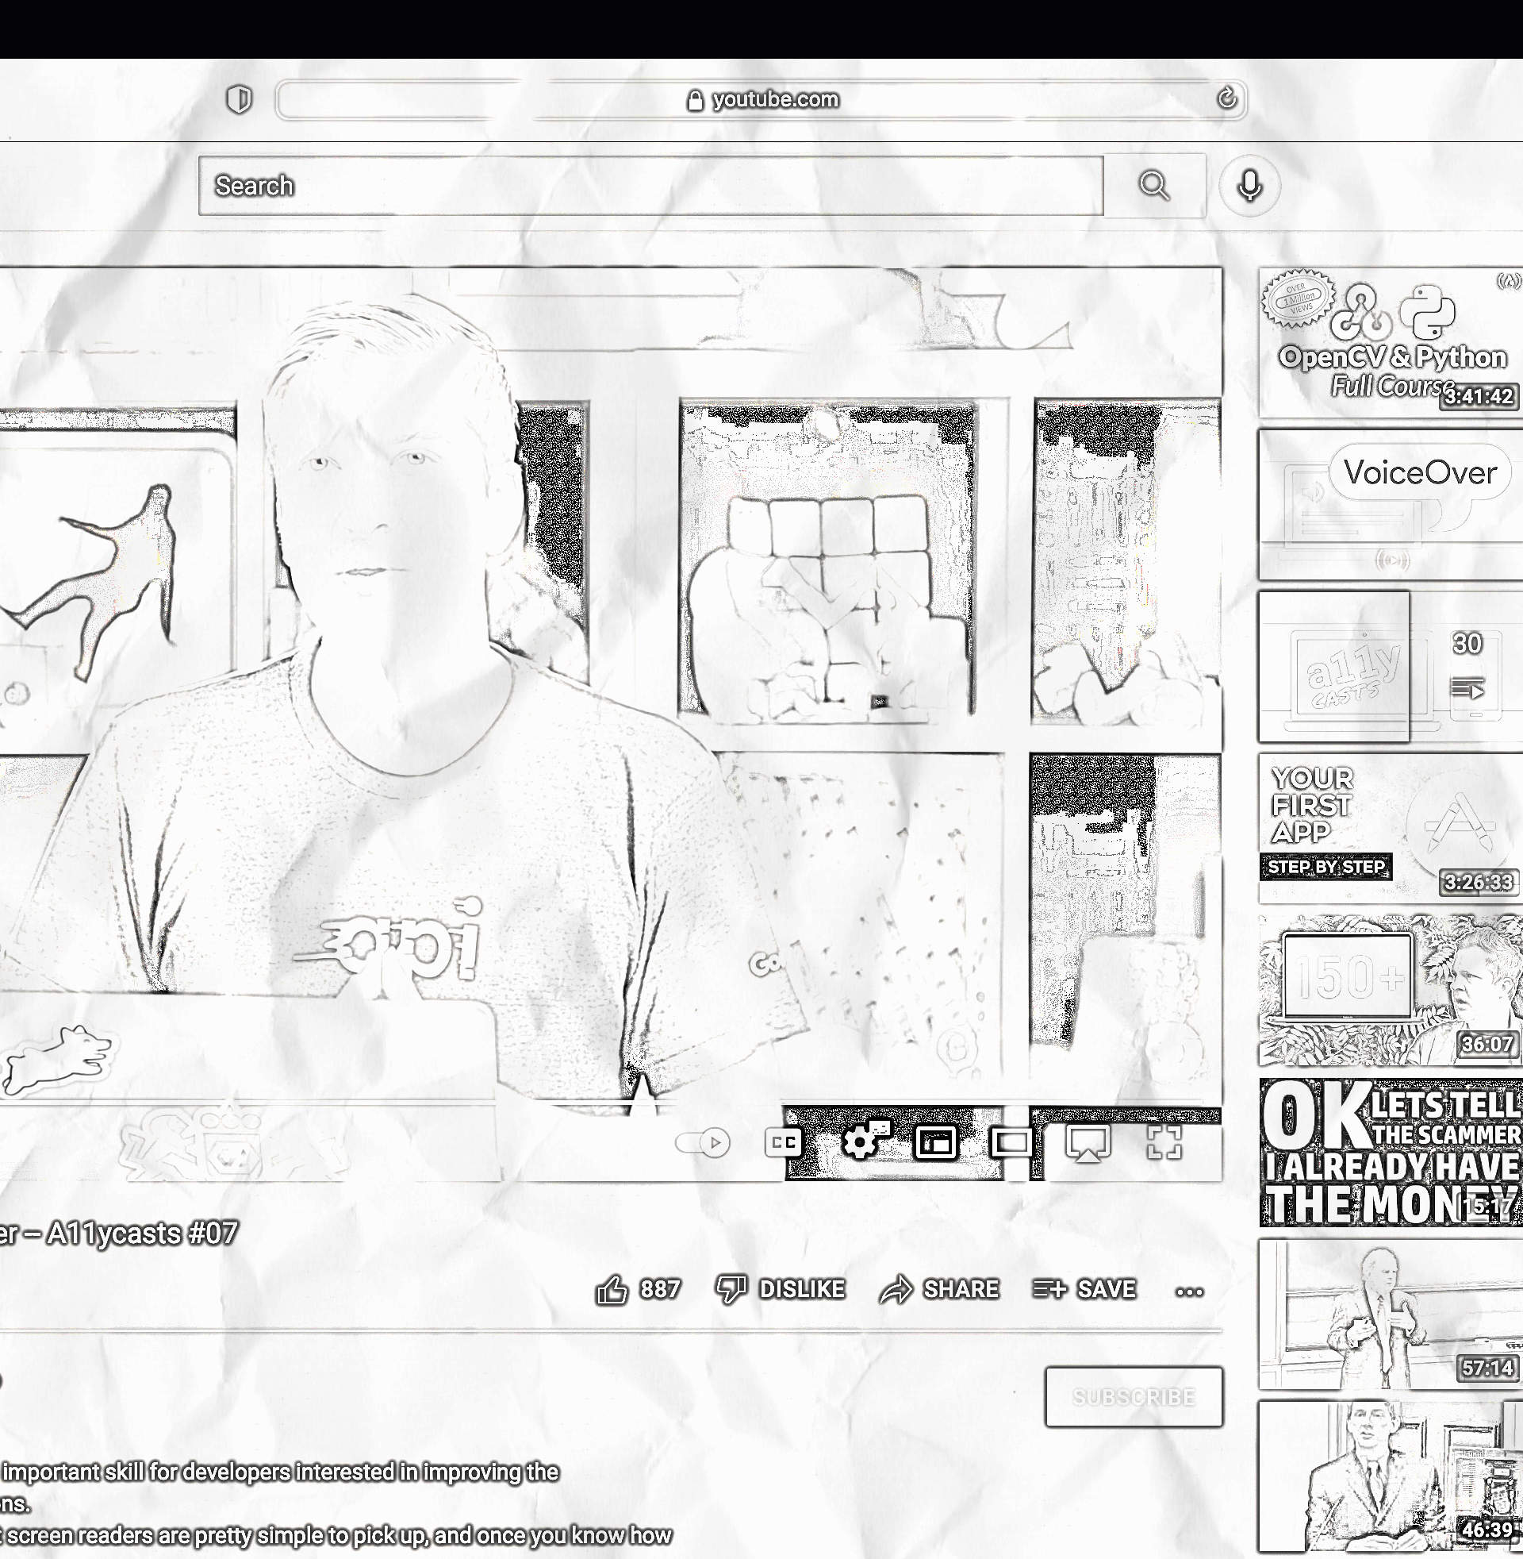
Screen Reader Basics: VoiceOver - A11ycasts #07
Google Chrome Developers. (2016). youtube.com

Slide 14
“Learning a screen reader is an important skill for developers [and designers] interested in improving the accessibility of their applications.”
- Google Chrome Developers, (2016)

Slide 15
On / off → command + F5
Stop talking → control
Modifier key → control + option
Navigate page → control + option + arrow
Navigate by heading → control + option + command + h
Click → control + option + space
…see documentation for more

Slide 16
Your Thoughts
Consider the following questions for our group discussion
Do you have any prior experience with screen readers?
Did you try a screen reader after watching this video?
How important is it for designers to consider voice?

Slide 17
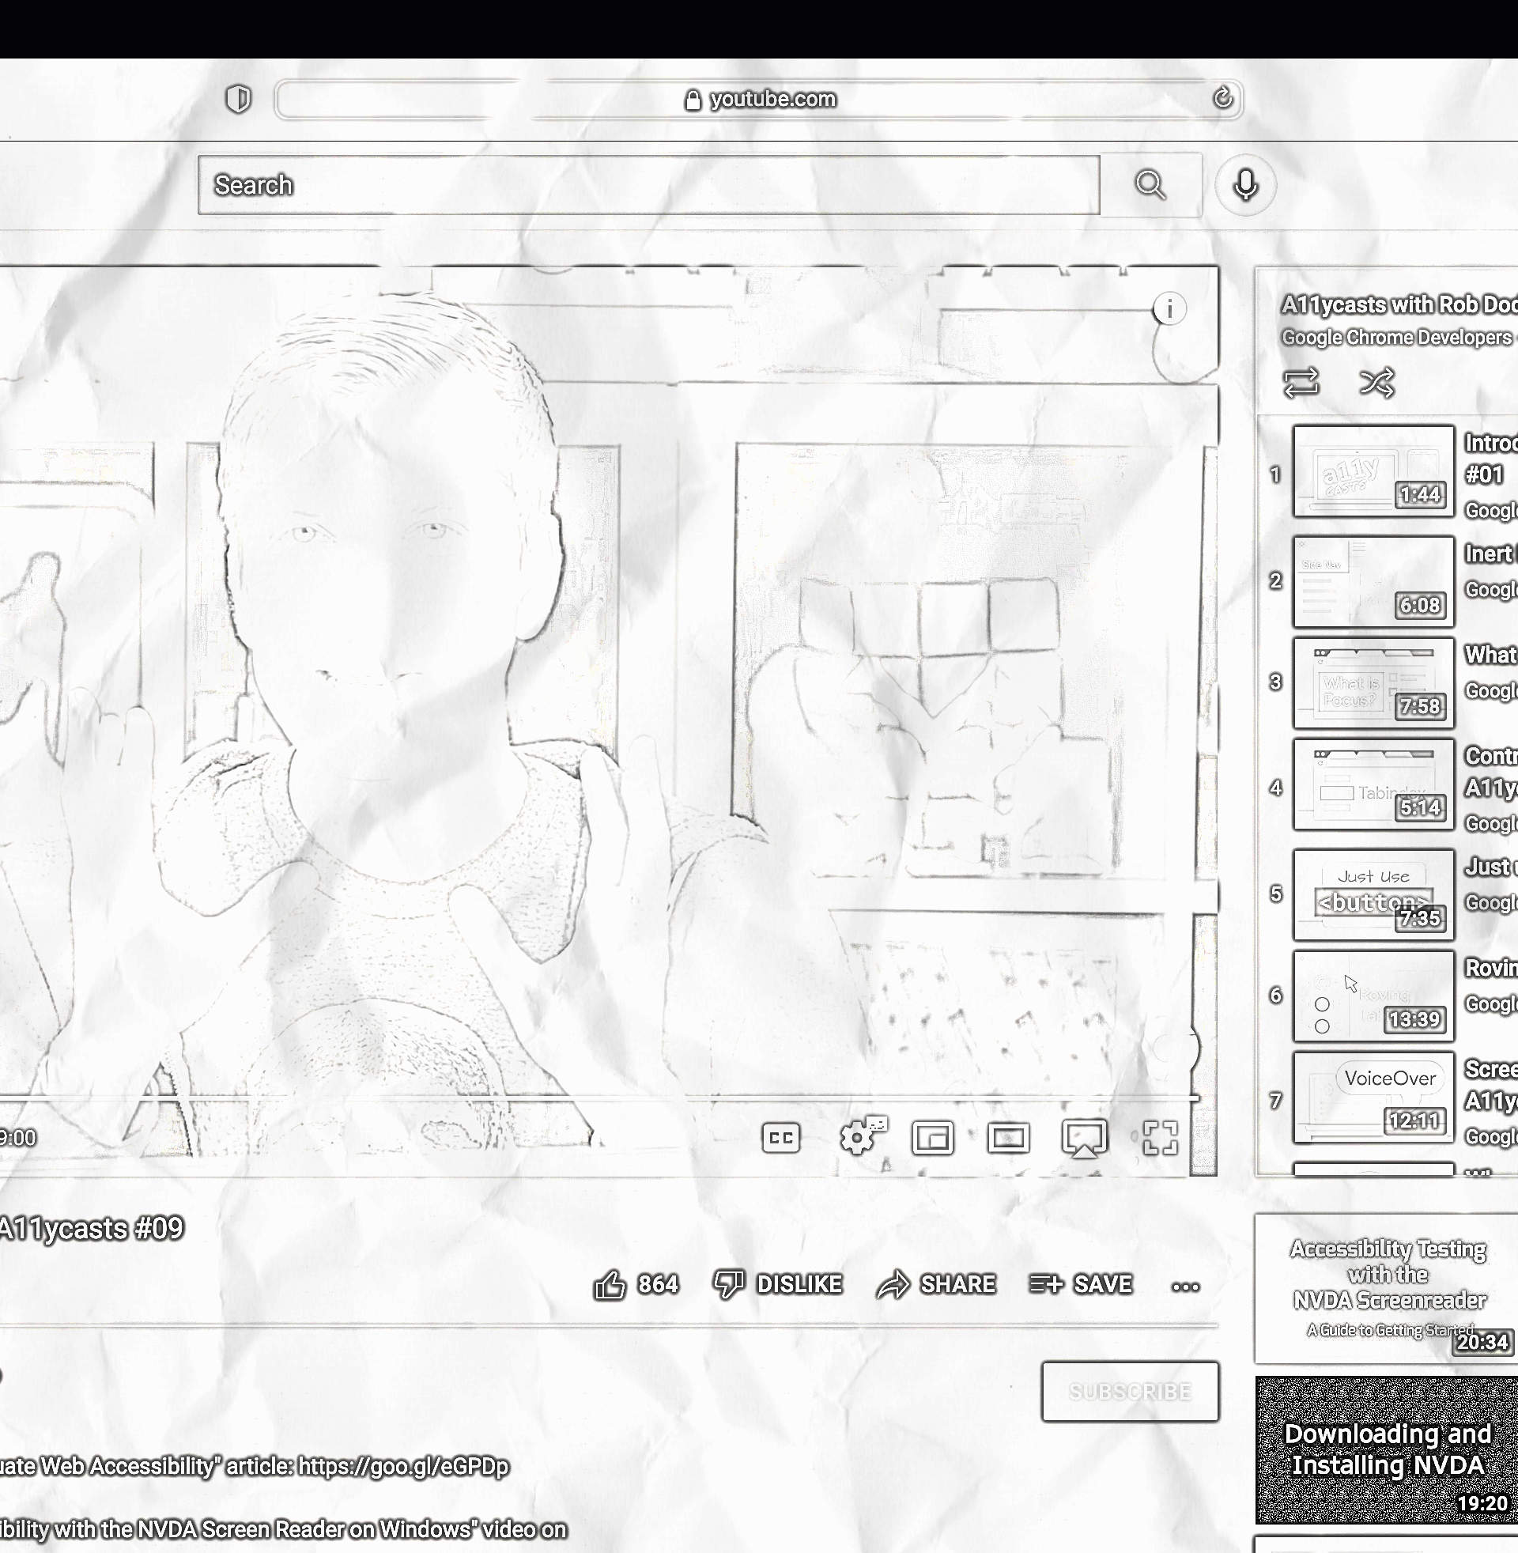
Screen Reader Basics: NVDA - A11ycasts #09
Google Chrome Developers. (2016). youtube.com

Slide 18
“If you're on a Windows machine and would like to get started with screen readers, NVDA is a great [free] option.”
- Google Chrome Developers, (2016)

Slide 19
Launch → control + alt + N
Stop talking → caps lock
Navigate by heading → H
Navigate by heading (backwards) → shift + H
Move by line → (up or down) arrow
…see documentation for more

Slide 20
Your Thoughts
Consider the following questions for our group discussion
Do you have any prior experience with screen readers?
Did you try a screen reader after watching this video?
How important is it for designers to consider voice?

